Slide 1


RNS INSTITUTE OF TECHNOLOGY
Department of Computer Science & Engineering
Project Presentation Review 2 -21CSP76
Project Title:
Online Voting System using Blockchain
Student Names:
Navaneeth N 1RN21CS098
Prarthana R 1RN21CS111
Rahul G Athreyas 1RN21CS118
Guide Name: Mr. Ranjith V Designation : Assistant Professor
Dept. of CSE, RNSIT
26 / 10 /2024

Slide 2
AGENDA
Summary of the previous Review
System Detail Design.
Project Modules.
Project Progress.
Conclusion.
References.
26 / 10 /2024

Slide 3
SUMMARY OF PREVIOUS REVIEW(REVIEW1)
Panel was okay with the idea and the work flow of the project, but asked to find the progress about e-voting in blockchain between 2021-2024.
26 / 10 /2024

Slide 4
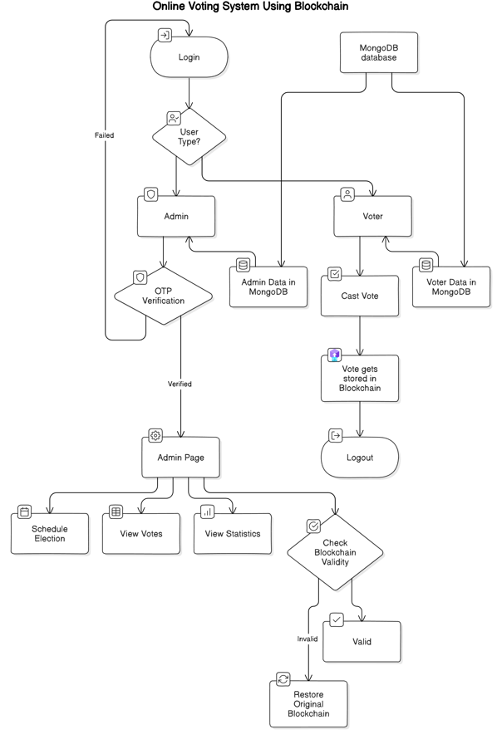
SYSTEM DETAIL DESIGN
26 / 10 /2024

Slide 5
PROJECT MODULES
Login
Voter
Admin
Schedule Election
Result
Statics
26 / 10 /2024

Slide 6
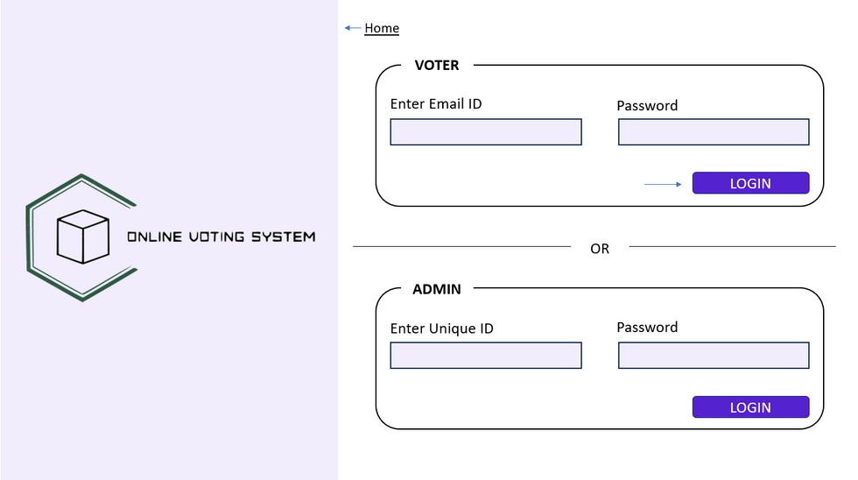
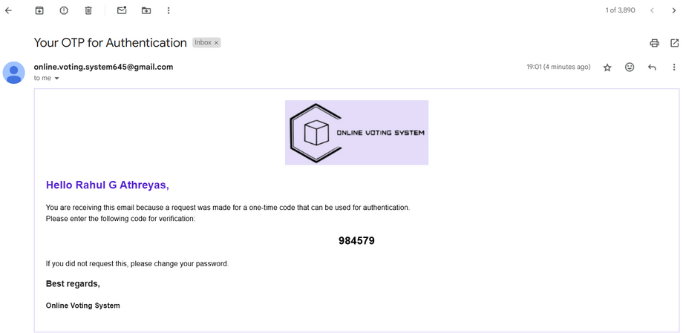
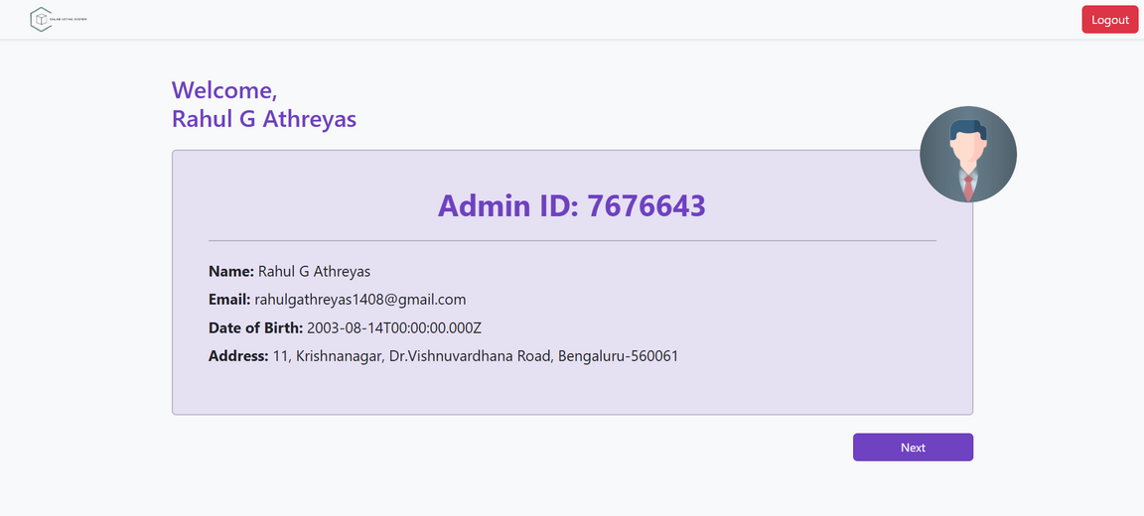
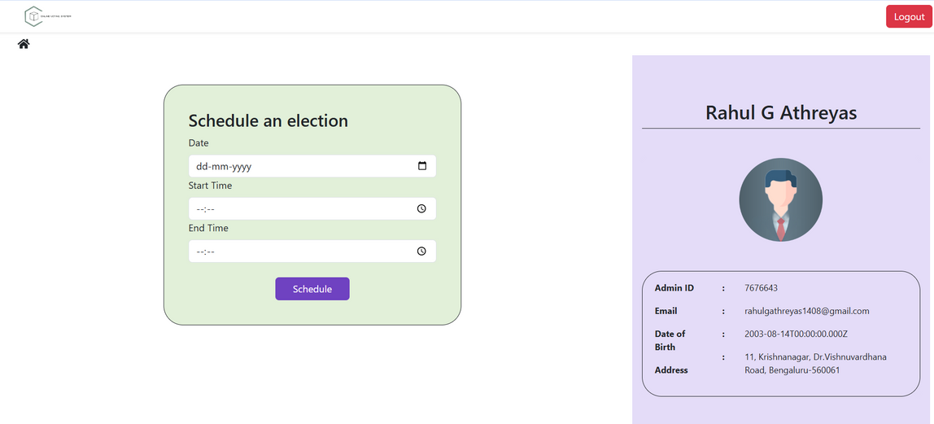
PROJECT PROGRESS
26 / 10 /2024

Slide 7

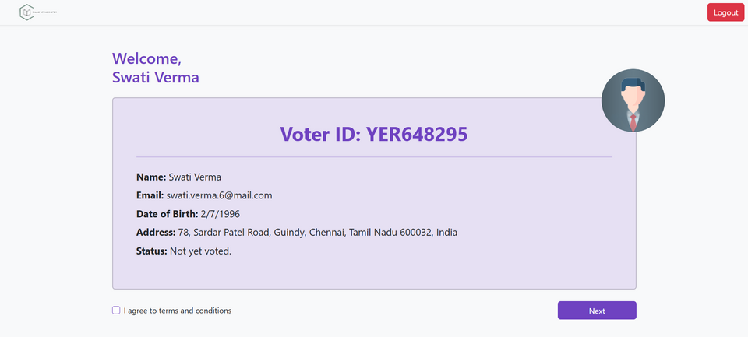
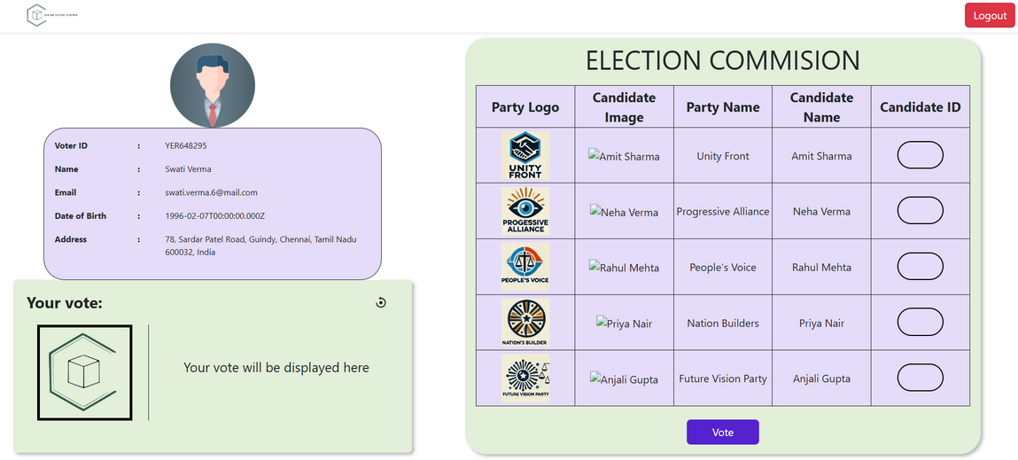
PROJECT PROGRESS
26 / 10 /2024

Slide 8
CONCLUSION
The system combines blockchain with the MERN stack to create a secure, decentralized, and user-friendly e-voting platform.
It addresses critical issues like security, transparency, and scalability, leveraging blockchain’s immutable ledger to maintain vote integrity and prevent tampering.
Voter privacy is safeguarded through decentralized data handling, ensuring only authorized access to vote records and strengthening trust.
A responsive MERN stack frontend and MongoDB backend provide a seamless user experience and scalable infrastructure for managing high voting volumes.
26 / 10 /2024

Slide 9
REFERENCES
Jafar, U.; Aziz, M.J.A.; Shukur, Z. Blockchain for Electronic Voting System—Review and Open Research Challenges. Sensors 2021, 21, 5874.
A. M. Larriba, A. Cerdà i Cucó, J. M. Sempere, and D. López, “Distributed trust, a blockchain election scheme,” ,2021.
M.-V. Vladucu, Z. Dong, J. Medina, and R. Rojas-Cessa, “E-voting meets blockchain: a survey,” IEEE Access, vol. 11, pp. 23293–23308, 2023.
M. H. Berenjestanaki, H. R. Barzegar, and C. Pahl, “Blockchain-based e-voting systems: a technology review,”Electronics, vol. 13, no. 1, Article ID 17, 2024.
26 / 10 /2024

